Slide 1
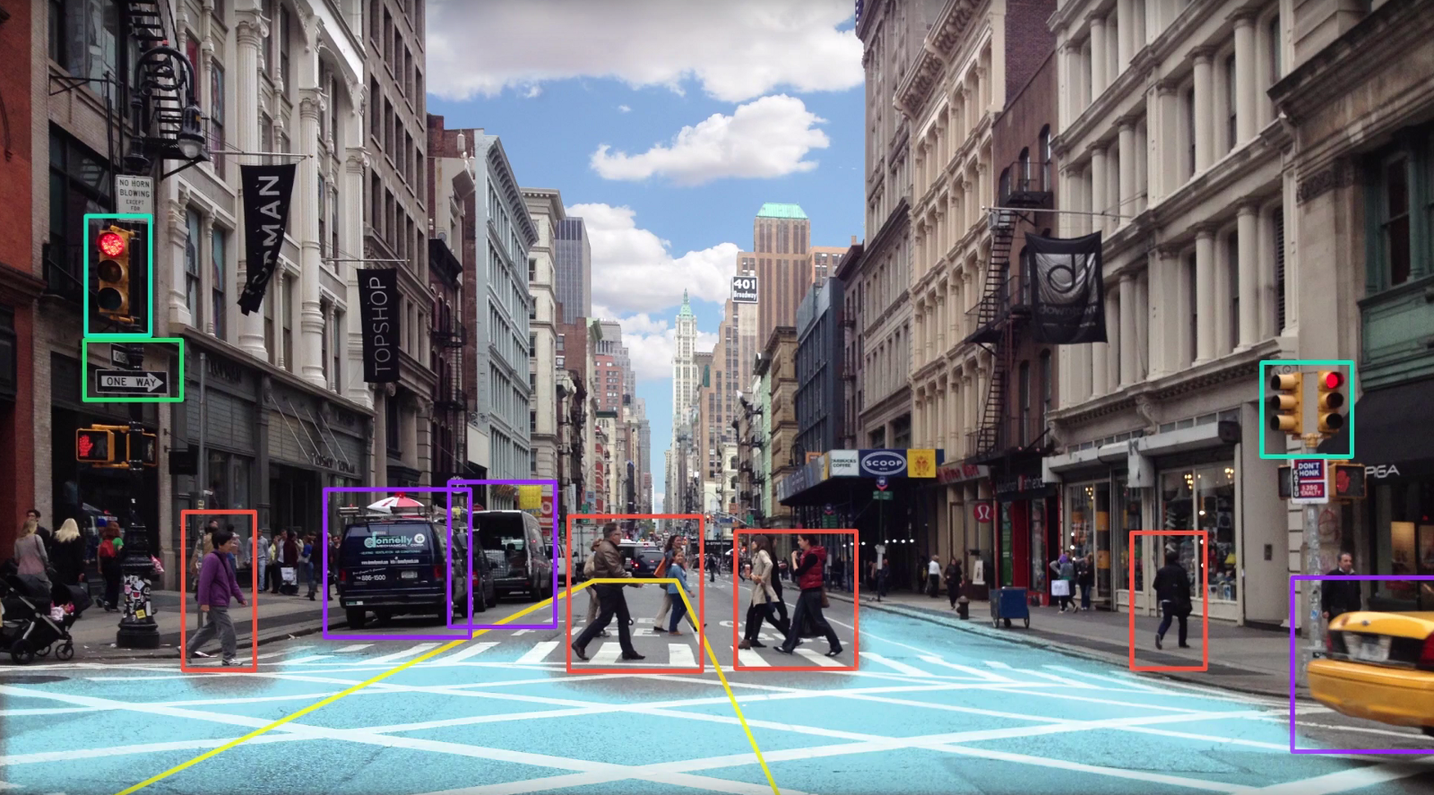
Convolutional Neural Network on Visual Recognition
Final Project

Slide 2
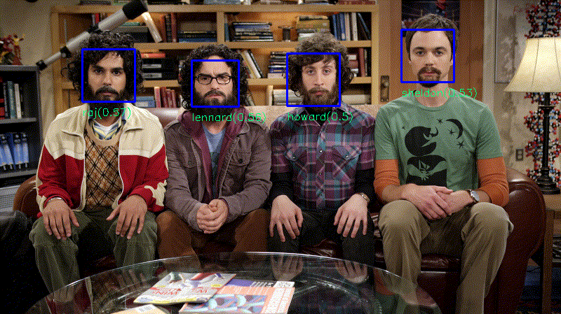
Outline
Visual Recognition
CNN on Visual Recognition
System Architecture
Result
Conclusion

Slide 3
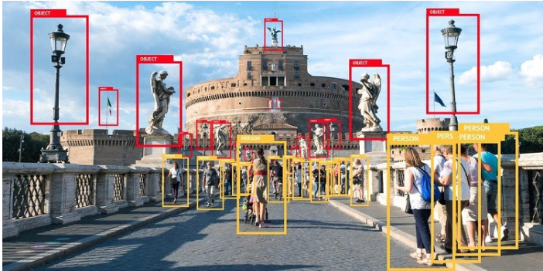
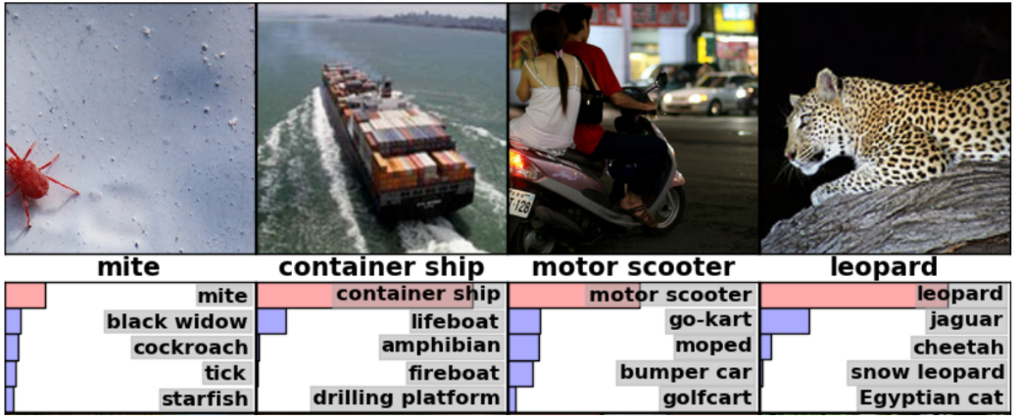
Visual Recognition
is the ability of software to identify objects, places, people, writing and actions in images.

Slide 4
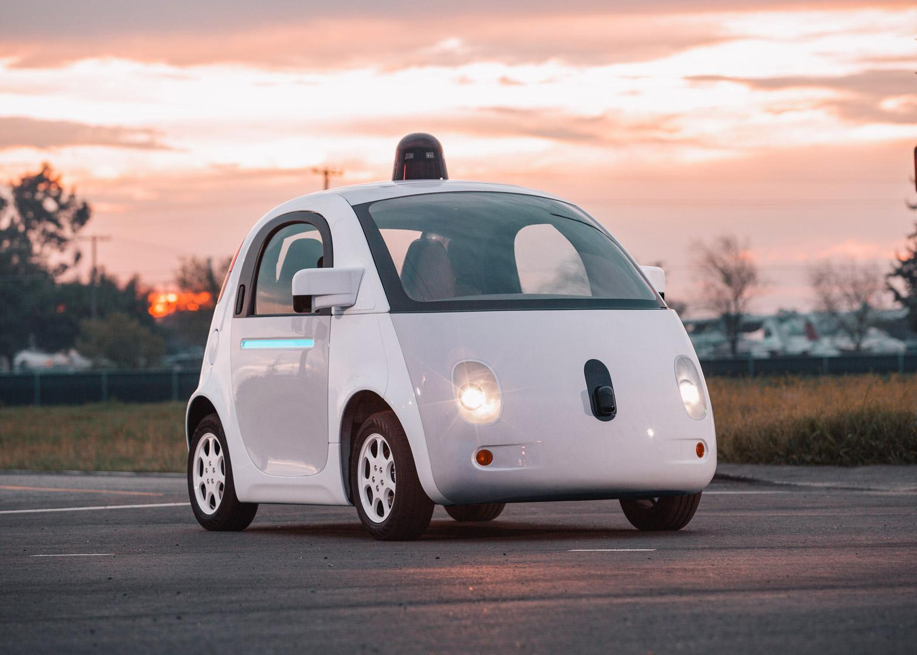
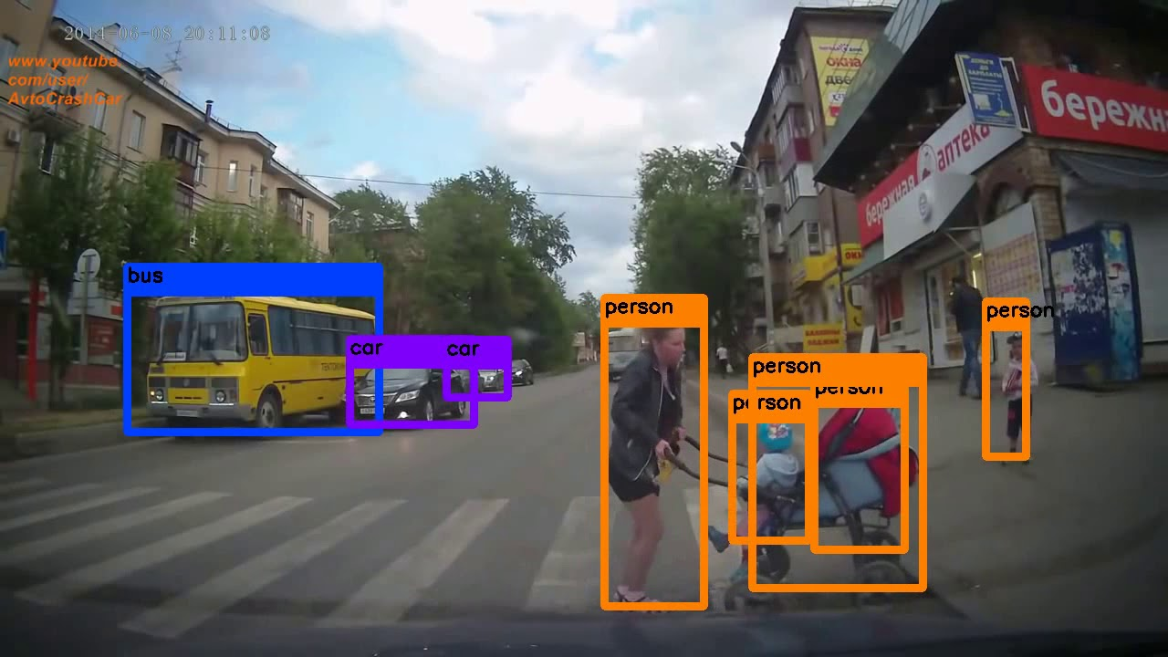
Visual Recognition
Automatic recognition
Surveillance system
Autonomous Self Driving Cars
Notes:
Face recognition has been one of the most interesting and important research fields in the past two decades. The reasons come from the need of automatic recognitions and surveillance systems, the interest in human visual system on face recognition, and the design of human-computer interface, etc. These researches involve know-ledge and researchers from disciplines such as neuroscience, psychology, computer vision, pattern recognition, image processing, and machine learning, etc.

Slide 5
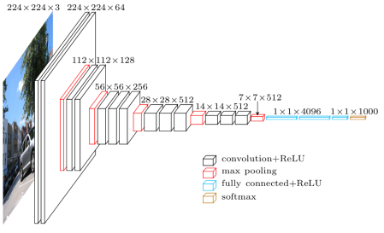
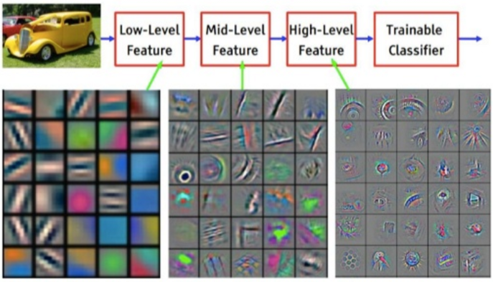
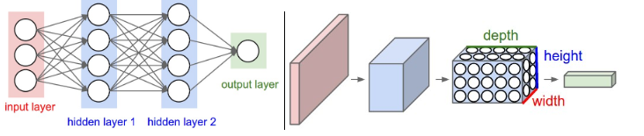
2. CNN on Visual Recognition
Inspired by Biological Processes taking place in the visual cortex.
Notes:
Convolutional Neural Networks take advantage of the fact that the input consists of images and they constrain the architecture in a more sensible way. In particular, unlike a regular Neural Network, the layers of a ConvNet have neurons arranged in 3 dimensions: width, height, depth.
As we will soon see, the neurons in a layer will only be connected to a small region of the layer before it, instead of all of the neurons in a fully-connected manner.
Recognising automatically people, garments, food, pets, and whatever is relevant can be very handy when it comes to manage and curate large sets of images, from ecommerce to blogging.
The field of machine learning has made a huge progress on addressing these difficult tasks. In particular, thanks to a kind of model called Convolutional Neural Network (CNN). They make up a class of deep neural networks inspired by biological processes taking place in the visual cortex. Individual neurons respond to stimuli only in a restricted region of the visual field that partially overlaps the region of close neurons, collectively covering the entire visual field.

Slide 6



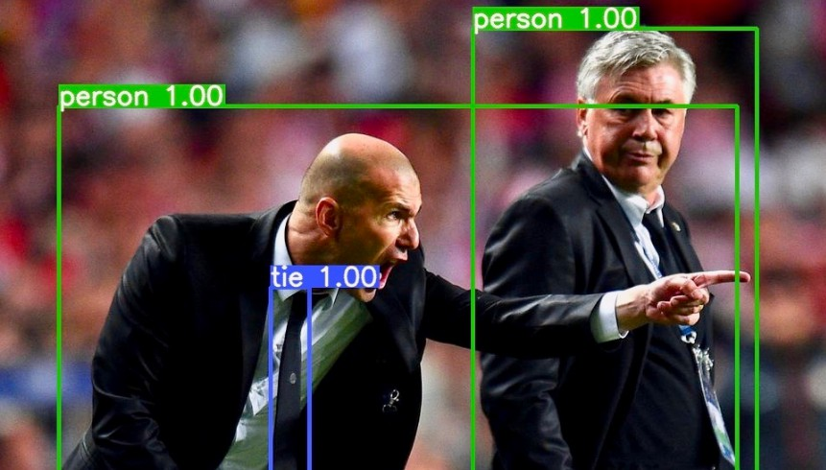
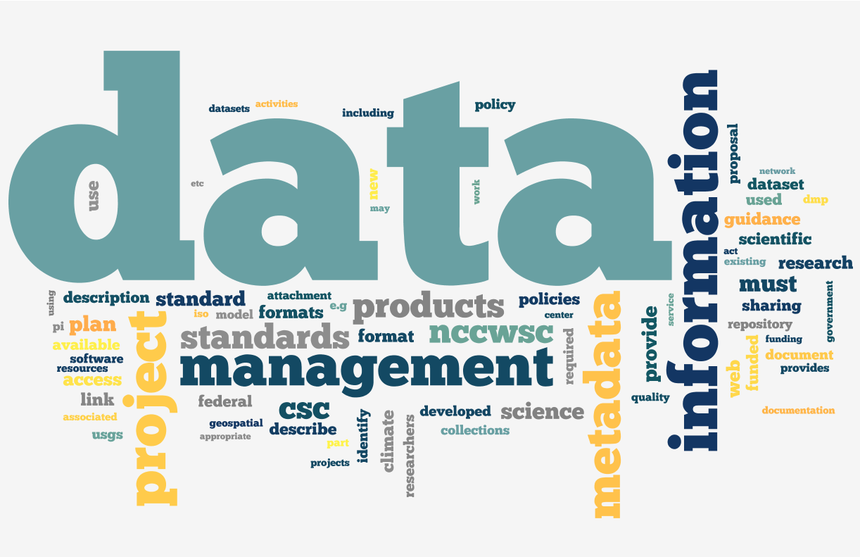

3. System Architecture
Algorithm and Network Architecture
Yolo + Darknet
Bounding box and Class prediction
Training data
Image
Video
Real-time Video
Input data

Slide 7
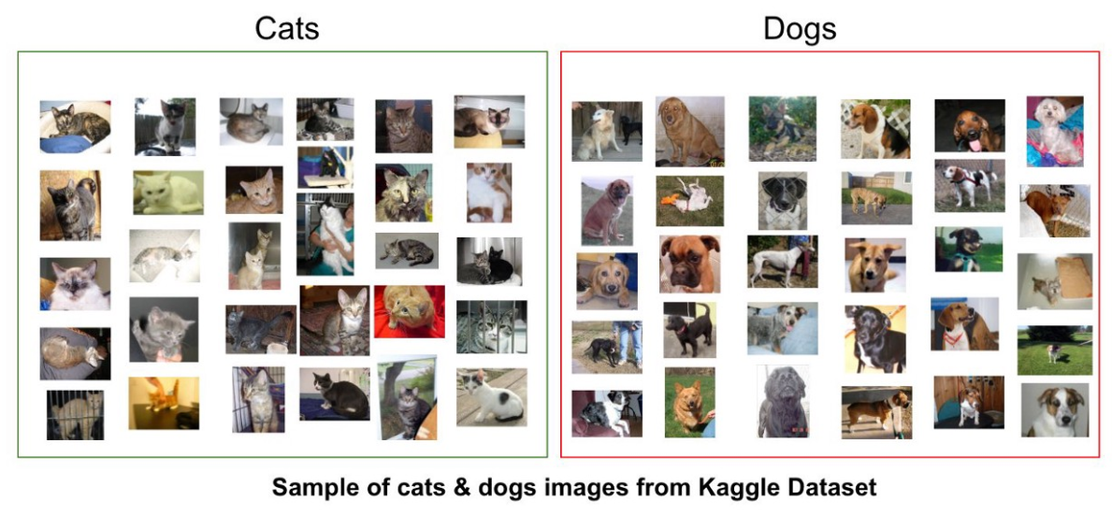
Training data
In order to train a network and the model can learn features and relations concern about object. Because of this, we need a enormous data
http://www.superdatascience.com

Slide 8

COCO dataset and NTUST campus data
Transfer Learning
Pretrained Weight
Custom Dataset
COCO is a large-scale object detection, segmentation, and captioning dataset. COCO has 80 class names
Custom dataset have 20 class names.

Slide 9


Importing Library and Open sources
Let’s first we need to import libraries and packages the we will need to do
Numpy
Matplotlib
OpenCV

Slide 10
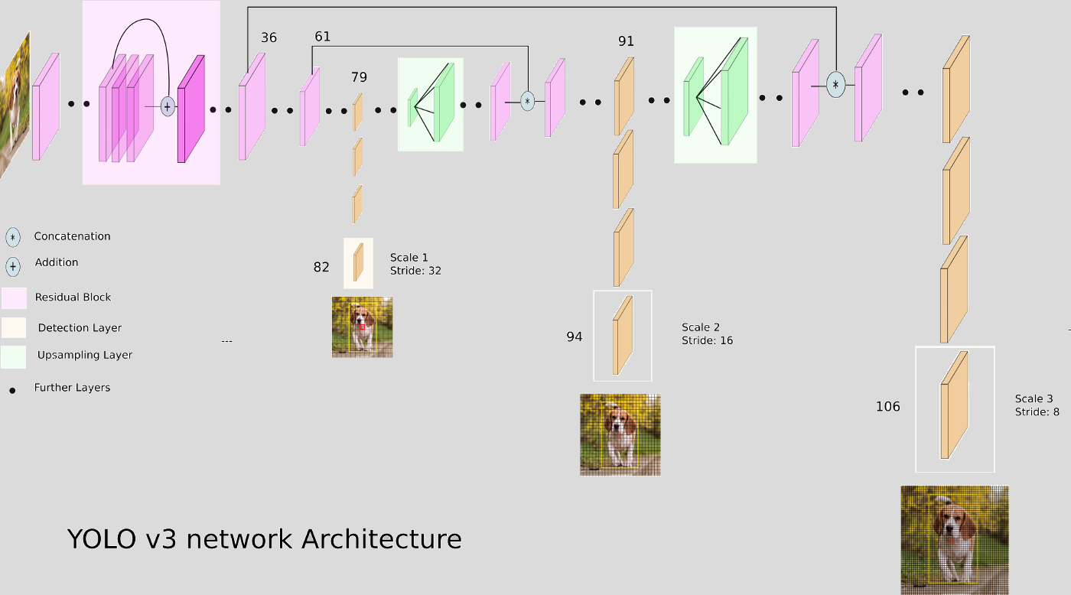
YOLO and Darknet

Slide 11
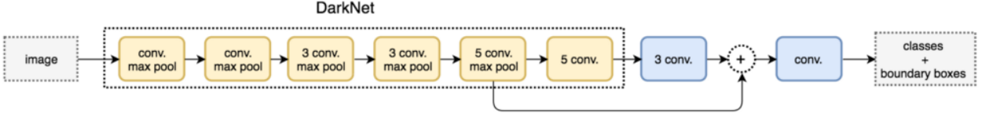
Tiny YOLO and Darknet
Tiny YOLO is the simplified version of YOLO that has smaller weight size
Use Darknet-53 as the backbone (YOLO v2 use Darknet-19)
YOLO v3 is similar with v2 except they change the Darknet network from 19 layers to 53 layers

Slide 12



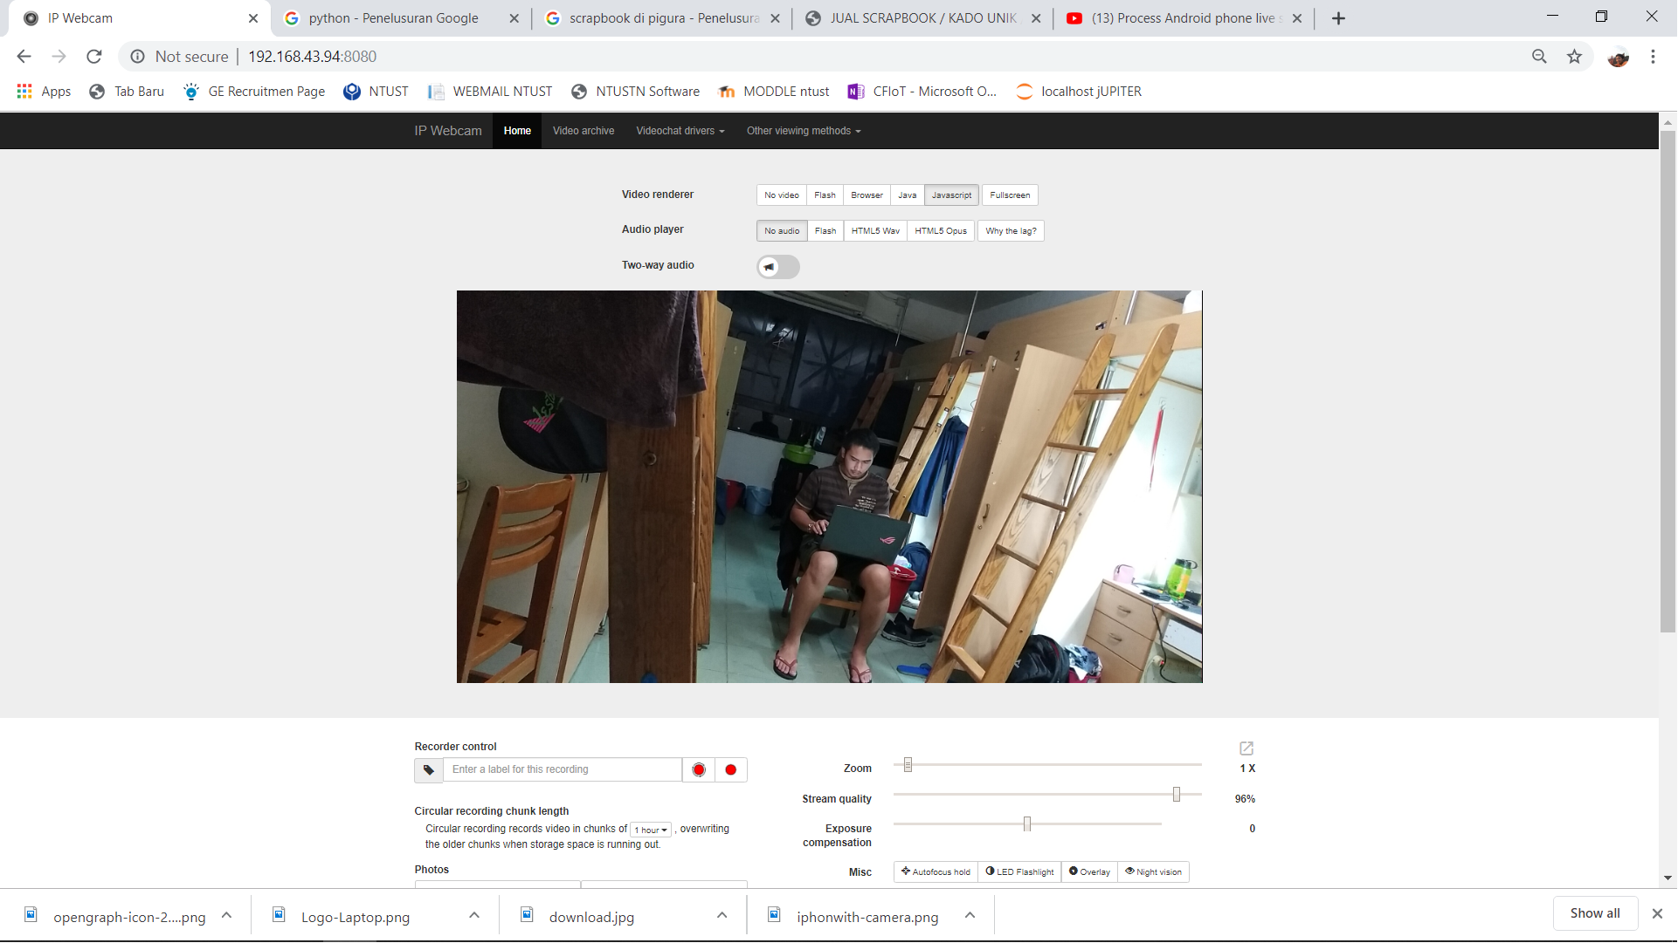

Real-Time Object Detection using External Camera
URL address
http://192.168.43.94:8080
Get real time image capture from URL address
http://192.168.43.94:8080/shot.jpg

Slide 13
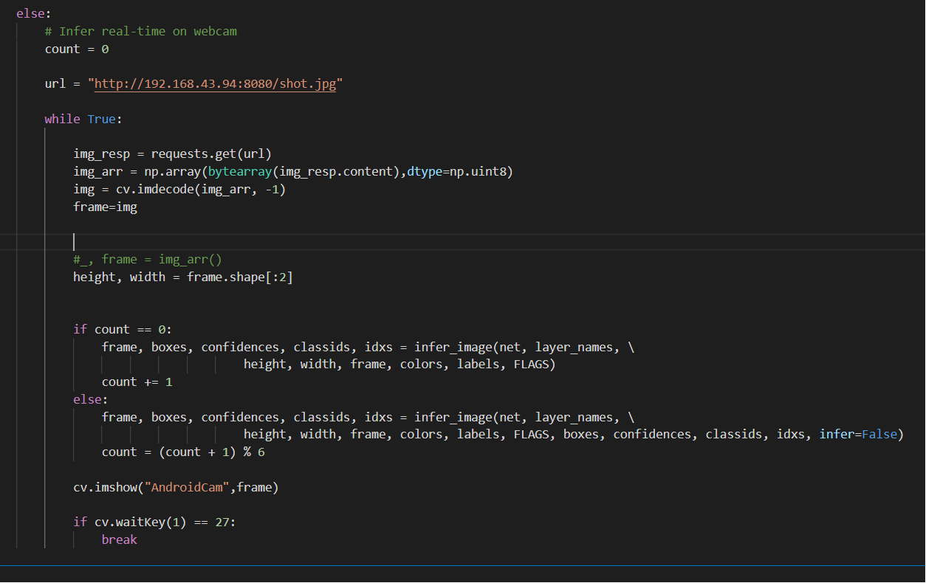
URL Adress to get the image using from IP WebCam Server
get the image from url
convert image form content into numpy byte array
convert image array into CV2 image object

Slide 14
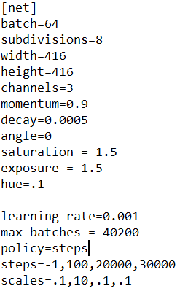
Training YOLO
Start
Labelling Image with LabelImg
A
Training Dataset: 229 Image
Validation: 8 Images
Batch Size: 64
Learning Rate=0.001
Network Resolution
416 x 416
Define classes and filter
Model
Change Threshold
Train Model
Analyze the result
No
Reached until 29000 ~ 32000 iteration?
yes
A

Slide 15
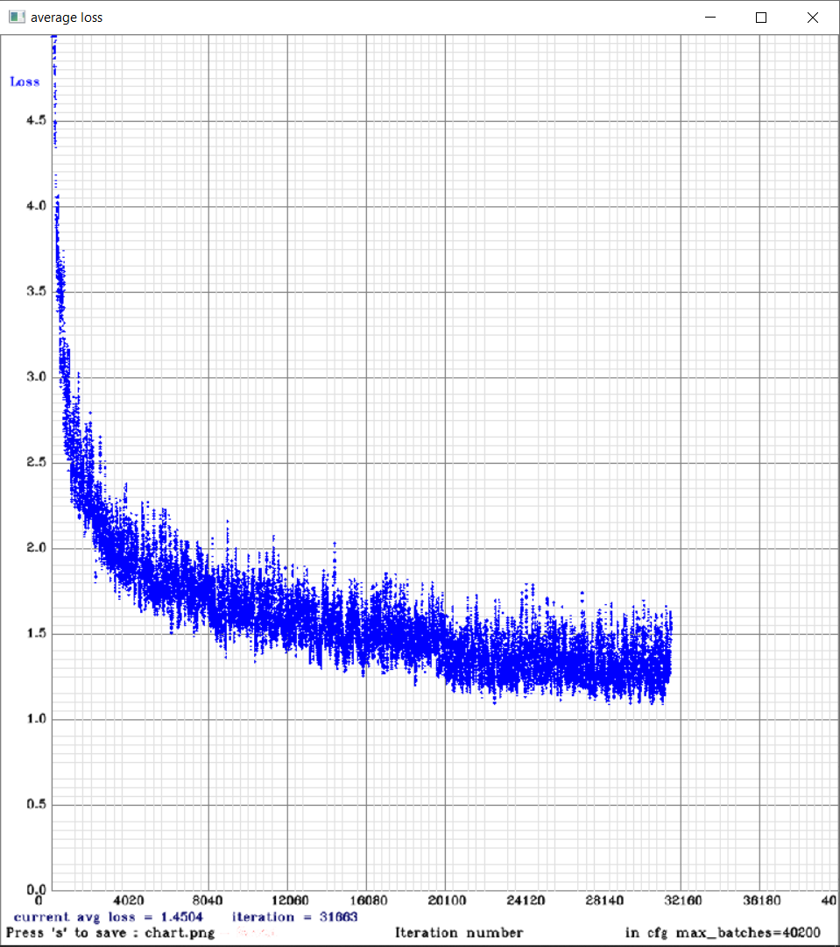
Test result
Lost function value
Average loss decrease from initial point + 5% become 1.4504% at iteration 31663

Slide 16

Output
Notes:
After building your CNN, you can use another image in order to try the accuracy of the classification of your network

Slide 17
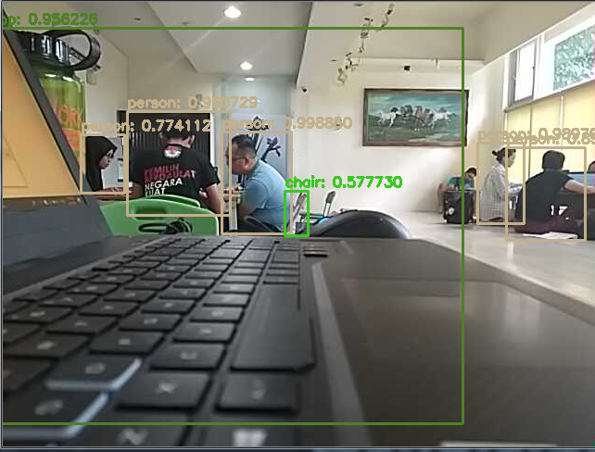
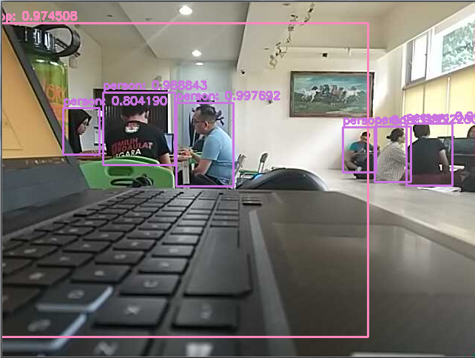
Output Evaluation
Learning rate : 0.1, Confident: 0.5, Threshold: 0.3
Learning rate : 0.01, Confident: 0.5, Threshold: 0.3

Slide 18
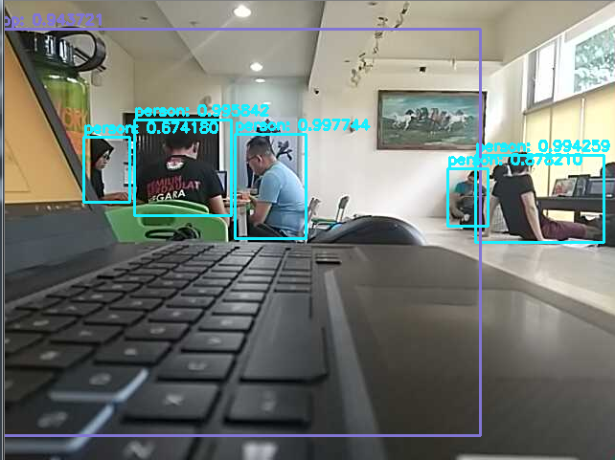
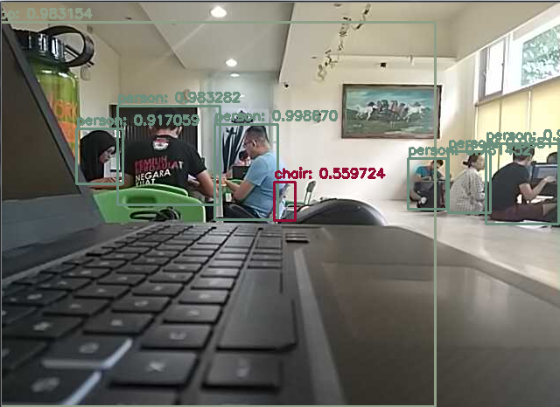
Learning rate : 0.001, Confident: 0.5, Threshold: 0.3
Learning rate : 0.0001, Confident: 0.5, Threshold: 0.3
The smaller value of the learning rate, the system can recognize more object

Slide 19
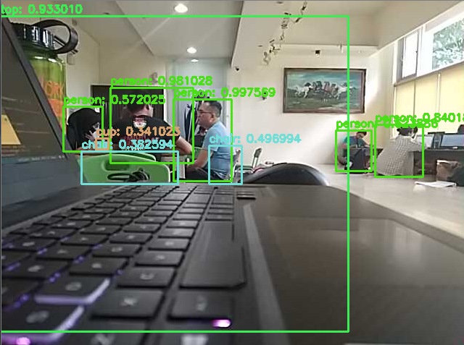
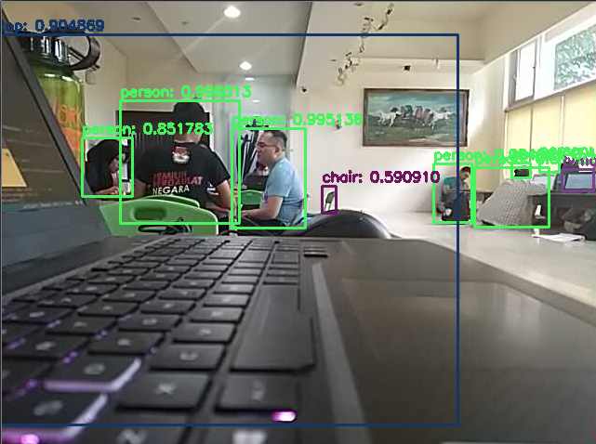
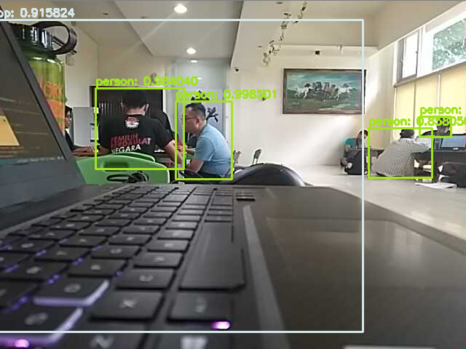
Learning rate : 0.01, Confident: 0.1, Threshold: 0.3
Learning rate : 0.01, Confident: 0.3, Threshold: 0.3
Learning rate : 0.01, Confident: 0.7, Threshold: 0.3

Slide 20
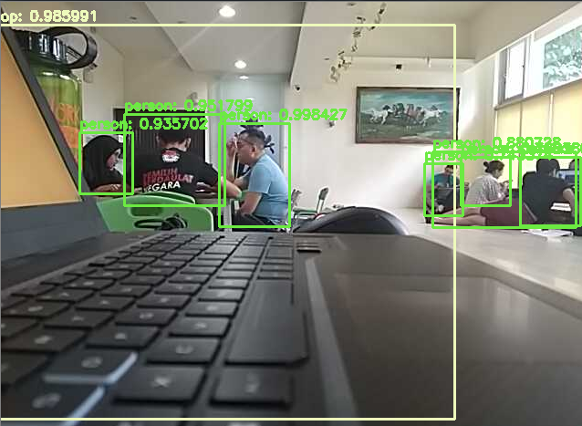
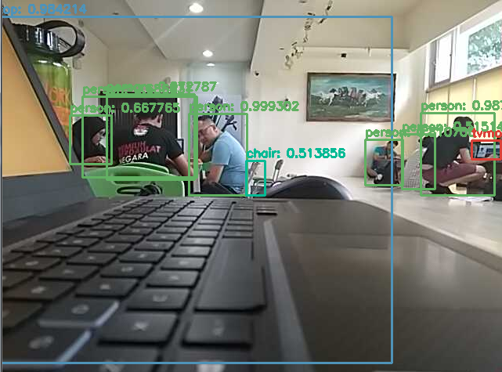
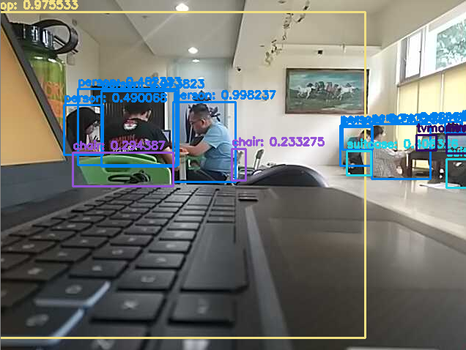
Learning rate : 0.01, Confident: 0.5, Threshold: 0.5
Learning rate : 0.01, Confident: 0.5, Threshold: 0.8
Learning rate : 0.01, Confident: 0.1, Threshold: 0.8

Slide 21
4. Conclusion-- result based on previous research
After implemented a transfer learning process, average loss decrease from initial point + 5% become 1.4504% at iteration 31663.
Higher learning rate (0.01) converge faster than the smaller one (0.001).
An object from single image can be recognize more detail using smaller learning rate (0.001) than learning rate (0.01).
Between threshold value of 0.1 to 0.7 the best one is 0.3

Slide 22
Reference
B. T. Nugraha and S. Su, "Analysis of Layer Efficiency and Layer Reduction on Pre-Trained Deep Learning Models," 2018 International Conference on System Science and Engineering (ICSSE), New Taipei, 2018, pp. 1-6. doi: 10.1109/ICSSE.2018.8520080
Nguyen, Hung & Maclagan, Sarah & Nguyen, Tu & Nguyen, Thin & Flemons, Paul & Andrews, Kylie & Ritchie, Euan & Phung, Dinh. (2017). Animal Recognition and Identification with Deep Convolutional Neural Networks for Automated Wildlife Monitoring. Doi: 10.1109/DSAA.2017.31.
Burt JR, Torosdagli N, Khosravan N, RaviPrakash H, Mortazi A, Tissavirasingham F, et al. Deep learning beyond cats and dogs: recent advances in diagnosing breast cancer with deep neural networks. Br J Radiol 2018; 91: 20170545. doi: 10.1259/bjr.20170545
others

